Slide 1
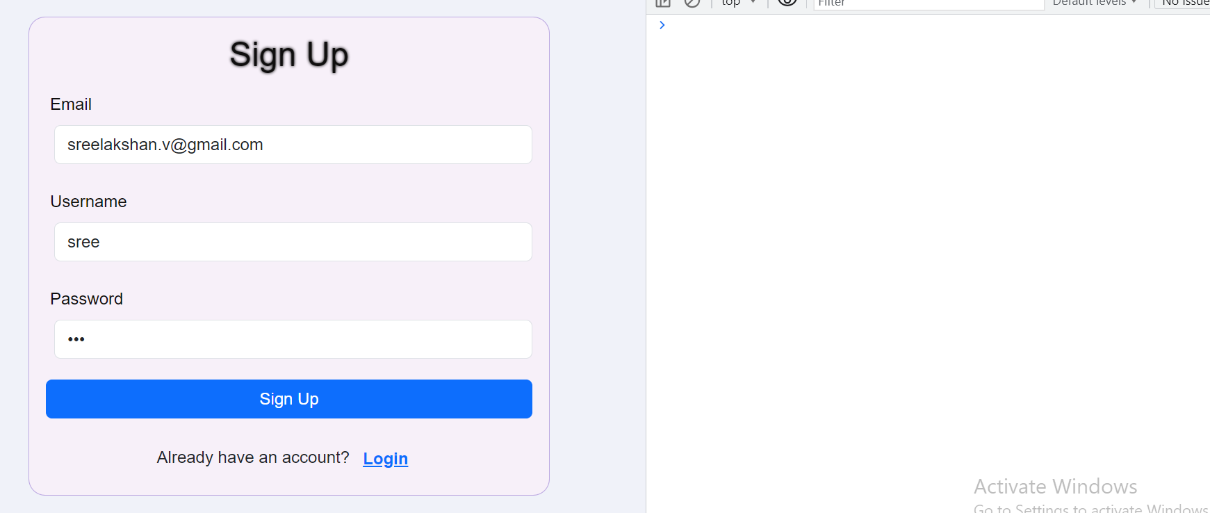
Sign Up

Slide 2
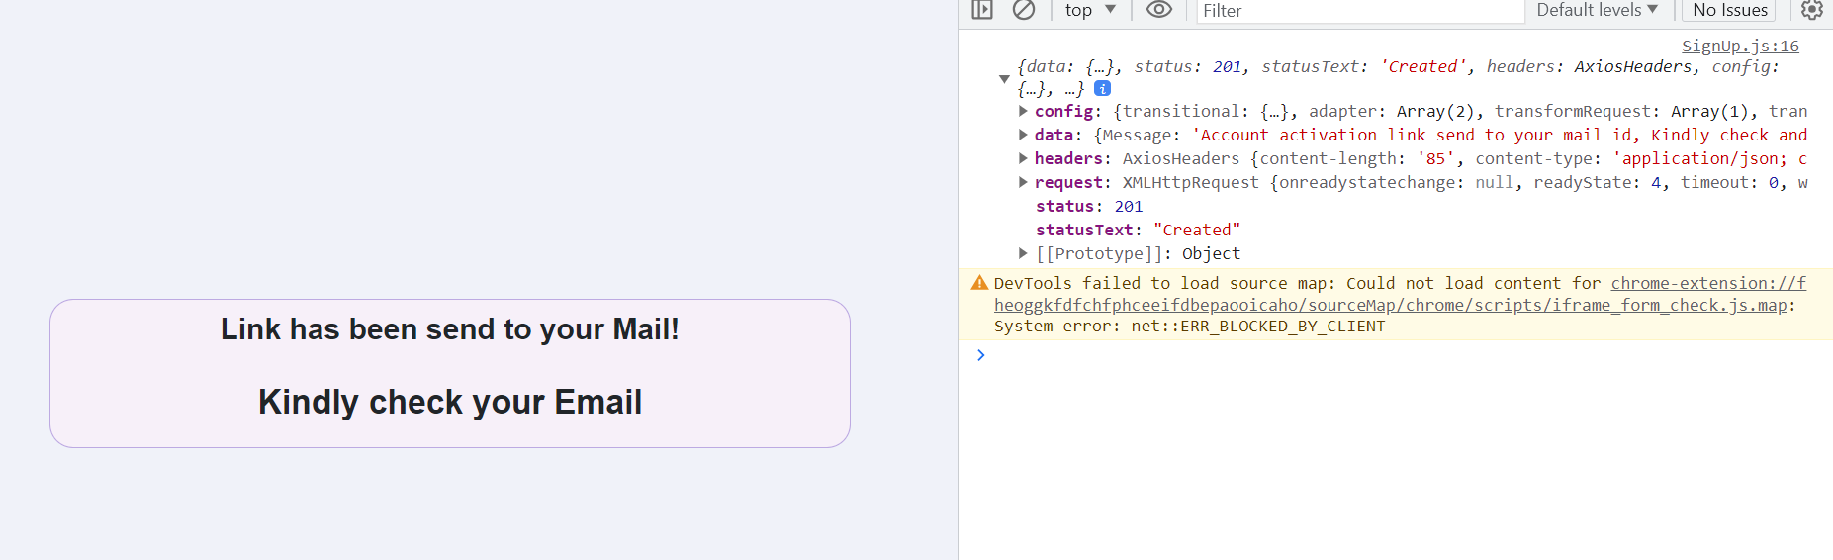
Click Sign up button get activation link in mail

Slide 3
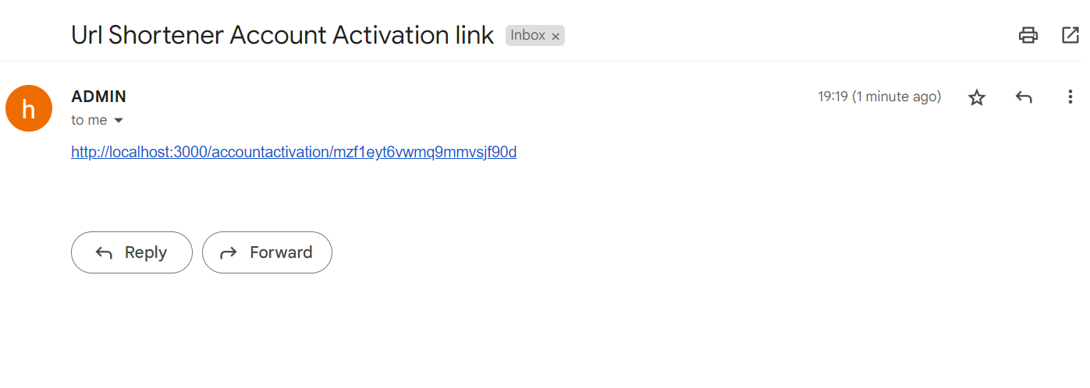
Got activation link in mail, click the link

Slide 4
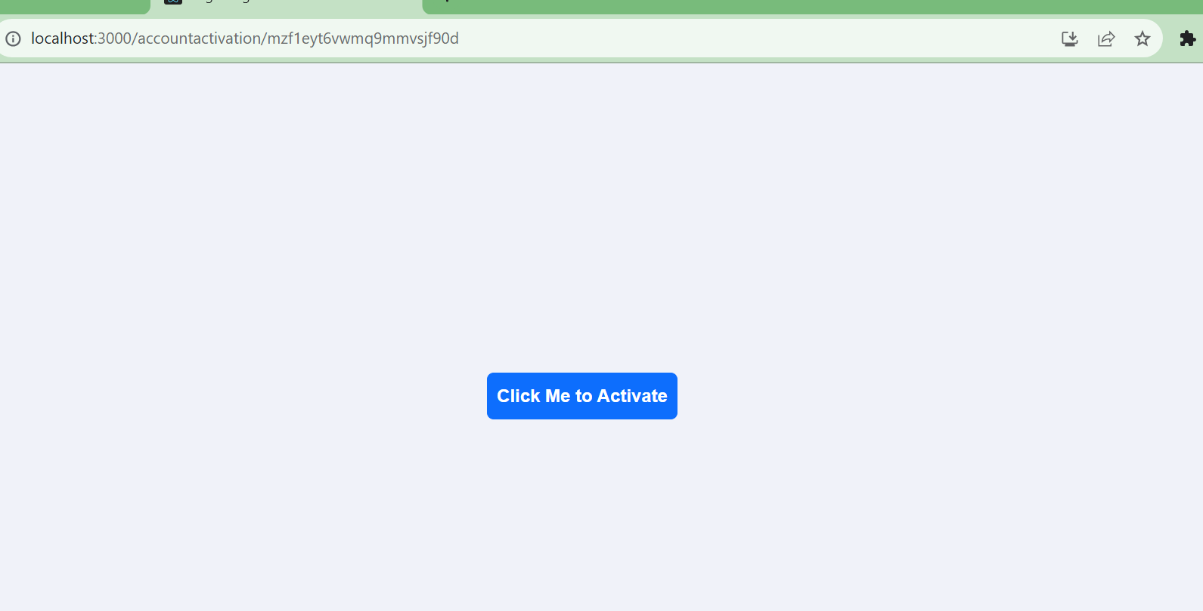
click the button to activate account

Slide 5
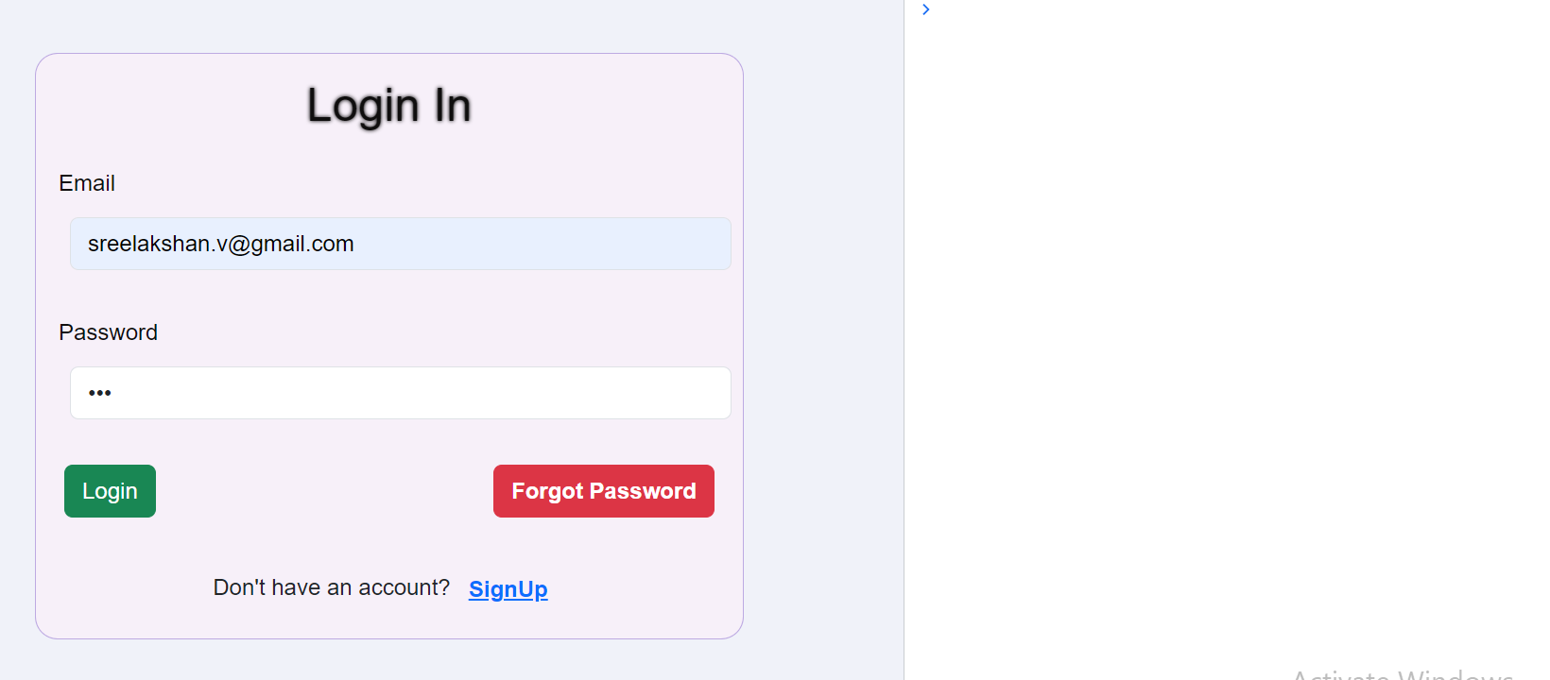
Login page

Slide 6
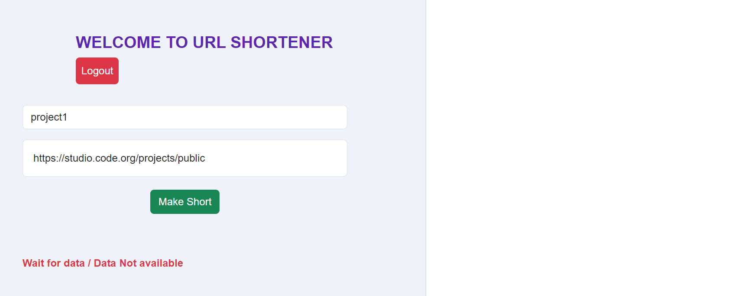
Click Login button, enter url title and long url and click make short Button

Slide 7
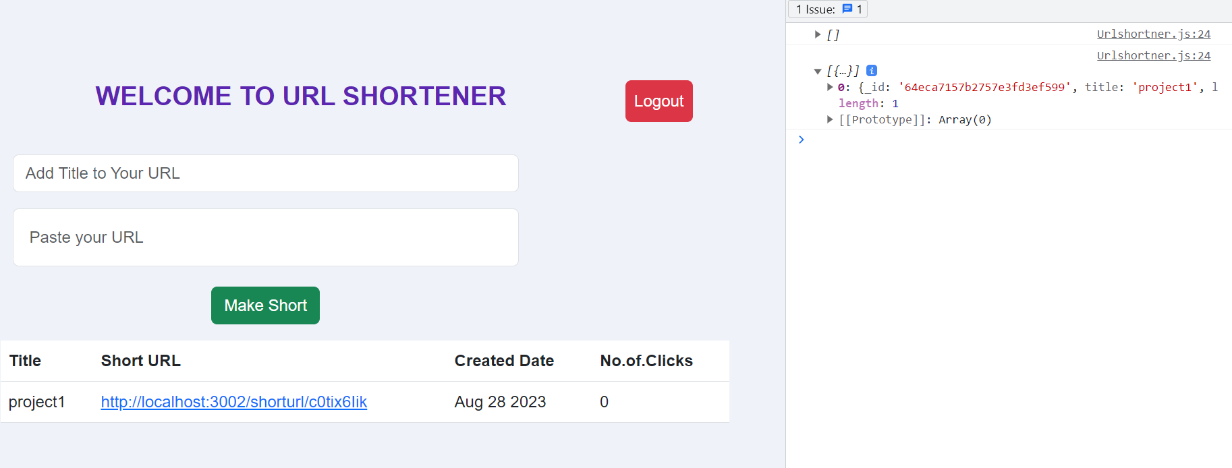
If make short button clicked

Slide 8
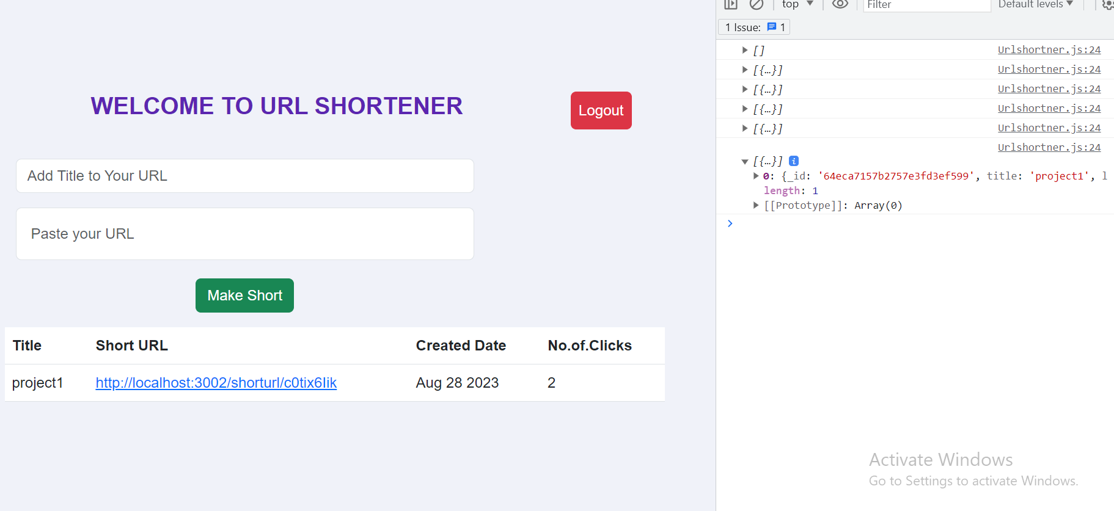
If Short URL Link clicked 2 times

